Slide 1

Tracker Powering Points
Satish Dhawan, Yale University
Richard Sumner , CMCAMAC LLC
ATLAS ITK week September 14-18, 2015 @ CERN, Geneva, Switzerland.

Slide 2
System Testing
DcDc Converter @ Yale . Tracker work stopped in 2009
Thickness of Converters – Shield thickness!
Tests @ Yale with FEAST 2 Chip mini-Module
ATLYS readout
Reduce mass/noise by using Fiber Carbon composite
(it works at higher frequencies but may be marginally useful at 2 MHz)
Prospects for Future
Lower Mass @ 5 MHZ
Topology Change Charge pump, Buck or something else?
GaN

Slide 3
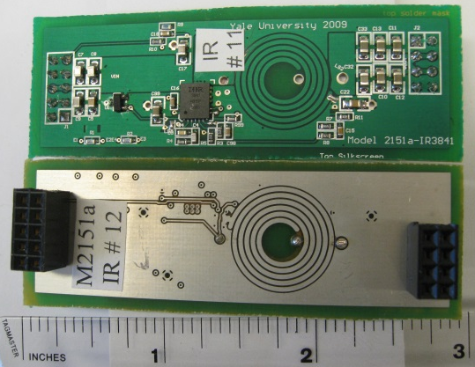
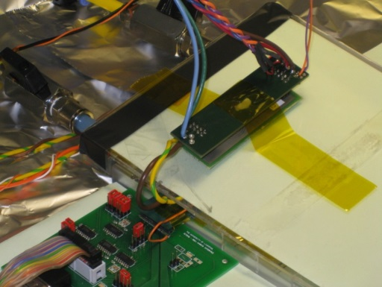
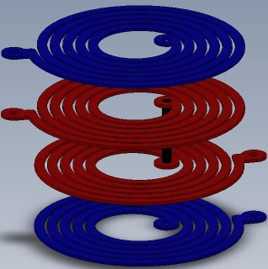
Old Cards
Liverpool Test
Paris Tweep 2009 –
US Atlas Decided in favor of Serial Power. Funding > zero
CERN Developed Toroid Inductors & FEAST Chip
UK Groups (Liverpool & RAL).
Requested a design with the YALE Planar Inductor.
Compare using the same commercial Chip as Toroid Design

Slide 4
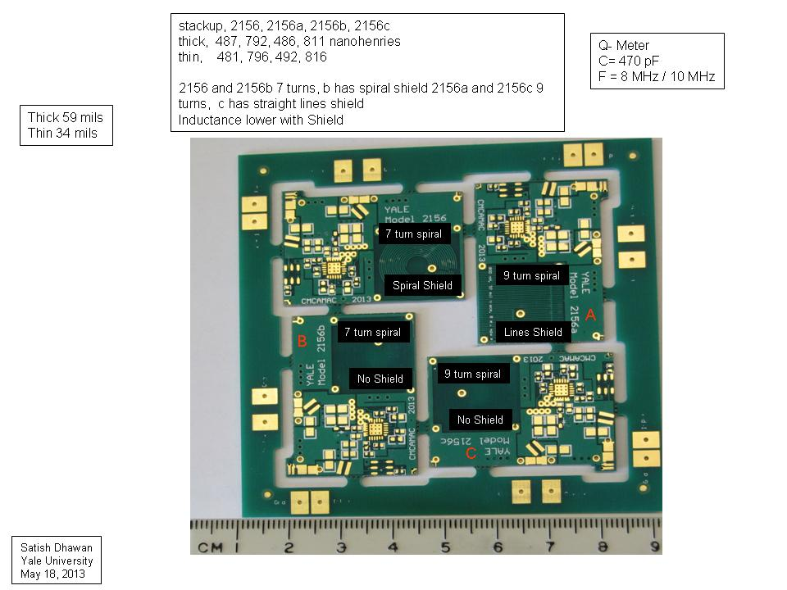
Vin_A
GND
Vin_D
GND
GND
Vout_D
Vout_A
Ver. 1
Spirals with LTC Chip
Same Circuit as for Toroid
but different PCB Layout
GND
GND
Vout_B
Vin_C
GND
GND
Vin_B
GND
Vout_C

Slide 5
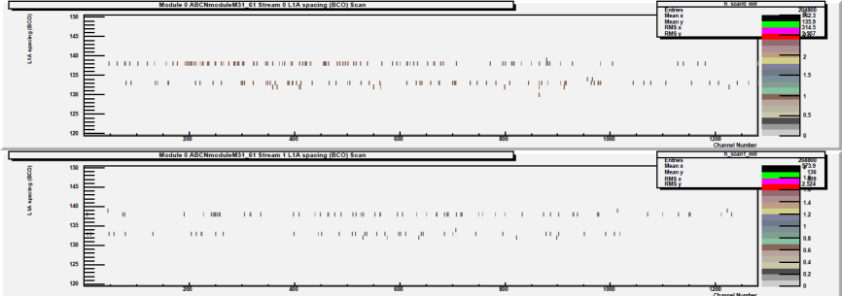
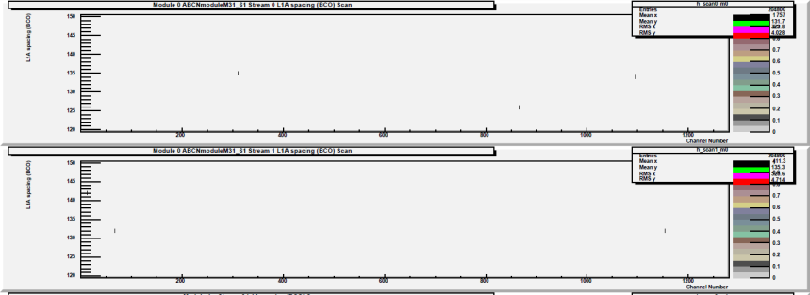
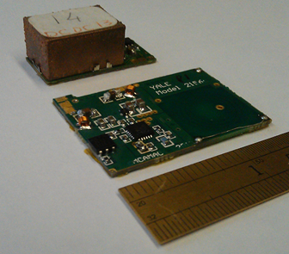
Planar Coil – “Up Close and Personal”
ATLAS Phase II Strip Tracker Meeting (3-7 February 2014, IFIC-Valencia, Spain)
Double Trigger Noise (DTN)
With Toroid Converter
With Planar Converter
Reference measurement (CERN STV10 converter) @ 0.5fC
Approx <3mm from wire bonds with improved reference @ 0.5fC
US ATLAS Moved towards Dc-Dc.
Ashley Greenall , UK Group
CERN converter registers zero occupancy until 0.5fC,
then registers 528/244 hits
For conducted noise configuration, Planar
coil registers zero occupancy(even at 0.5fC)
Only when close to asics are hits registered,
3/2 counts at 0.5fC, see above
Above picture is Double trigger noise
i.e. after a hit ; spurious counts are registered
Comments inserted by Yale University
Noise in Electrons Measured @ Liverpool
cern stv10 noise 589, 604 average = 601
yale planar noise 587, 589 average = 588
noise with dc supplies (no dcdc) = 580
assuming the noise adds in quadrature, extract noise due to dcdc converter:
cern stv10 Additional noise = 157
yale planar Additional noise = 96
Planar Converter uses the same components except Inductor coil
CERN stv
Yale Planar
Thickness of stv = 8 mm vs 3mm for Planar
Shield to Silicon strips are Electrostatics & Eddy current
Bottom side shield 2 mm from Planar coil traces
Can be mounted on the sensor with 50 µm Kapton
Cooling via sensor
Notes:
5

Slide 6
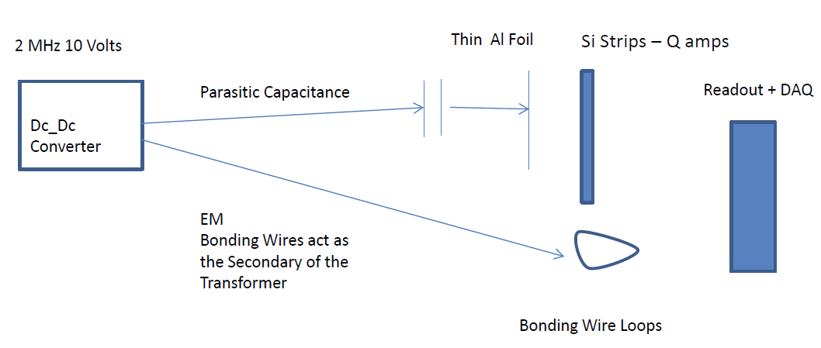
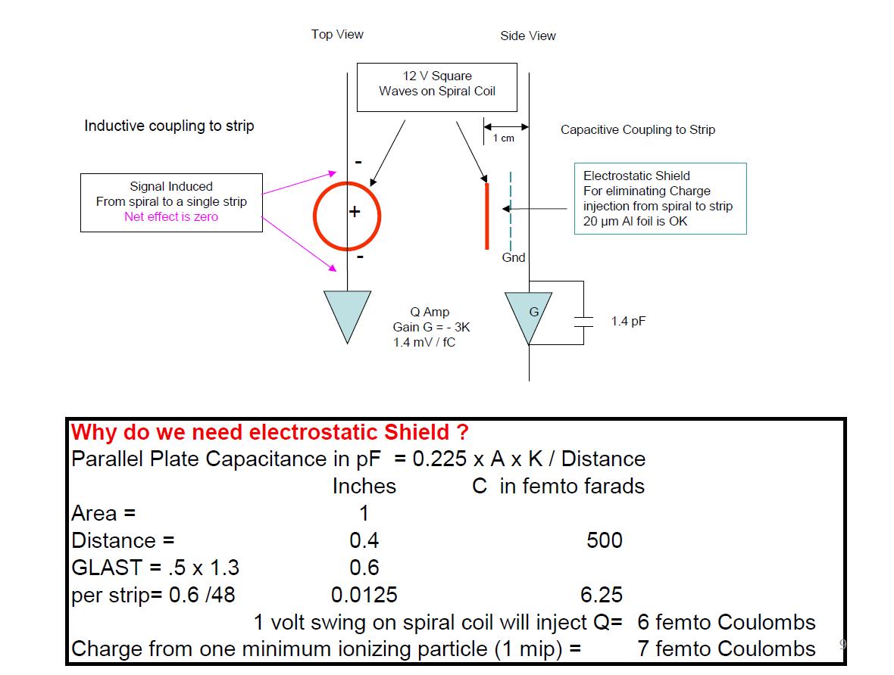
Noise Couplings
Electrostatic &
H field
Coupling/Shields

Slide 7
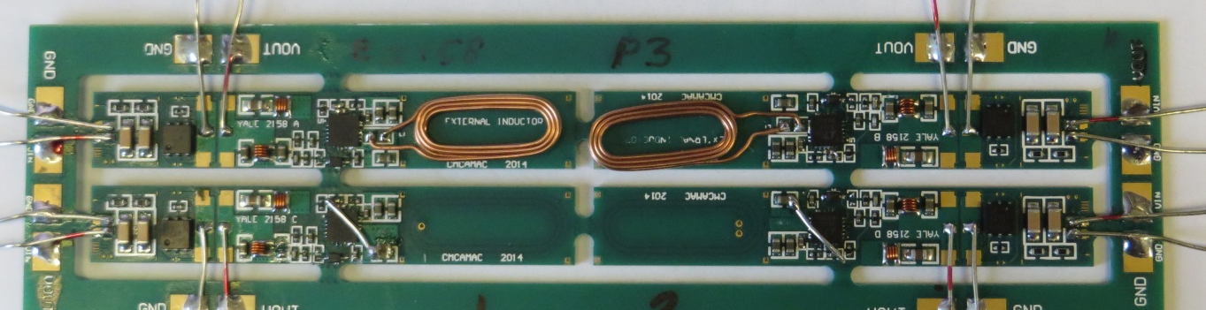
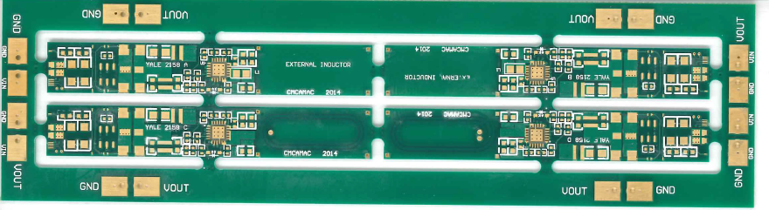
Ver. 2 OVAL / Spirals with LTC Chip
Each Converter PCB 10 mm x 63 mm. Different Coil Configuration
Channel D: Embedded Coil with 2 via: 687 nH, 83 mΩ
Channel C: Embedded Coil with 1 via: 703 nH, 83 mΩ
Channel B: External Coil: Wurth 540 nH* with short Leads
Channel A: External Coil: Wurth 540 nH* with short Leads
* With BK Precision LCR Meter
GND
Vout_A
Vout_B
GND
Vin_A
Yale E-2158
A
P #
B
Vin_B
GND
GND
Vin_C
GND
Vin_D
GND
GND
C
D
GND
Vout_C
Vout_D
GND
DC-DC Converter Model E-2158
Yale University
October 19, 2014

Slide 8

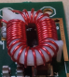
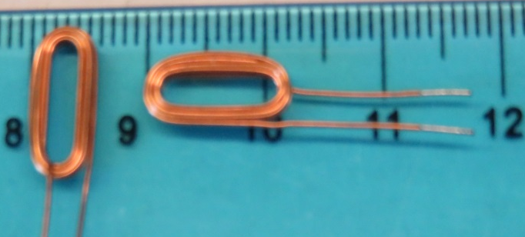
Toroid vs Planar Coil
Ver 1
Spirals
Toroid Inductors Designs- Round & Elliptical
Circa 2008
Lower Mutual Coupling if turns are further apart but adds to DC Resistance
Embedded Spirals
Disabled for the hand wound coil
Height = 2 mm plus shield
Toroid Inductor with Shield on toroid
height = 8 mm
Wurth Coil 5 mm x 8 mm
Wurth Coil 5 mm x 8 mm
9 turns (3 layers with 3 turs)
750 nH
July 2015
Coils squeezed in one direction for Mechanical

Slide 9
Comparison of toroidal inductor and planar inductor
 | toroid radius | coil radius |  |  | wire length | R | wire dia | volume | mass
toroid coil | mm | mm | turns | L | mm | mOhms | mm | cubic mm | grams
 | 4.5 | 1.7 | 32 | 413 | 342 | 32.5 | 0.48 | 129 | 1.1
planar coil | coil length
same L, same Ohms | 1.0 | 5.4 | 6 | 415 | 203 | 34.4 | 0.36 | 58 | 0.5
Same L, same mass of Copper | 1.0 | 5.4 | 6 | 415 | 203 | 8.5 | 0.72 | 115 | 1.0
same mass, same Ohms | 1.0 | 5.5 | 9 | 967 | 311 | 33.0 | 0.46 | 111 | 1.0

Slide 10
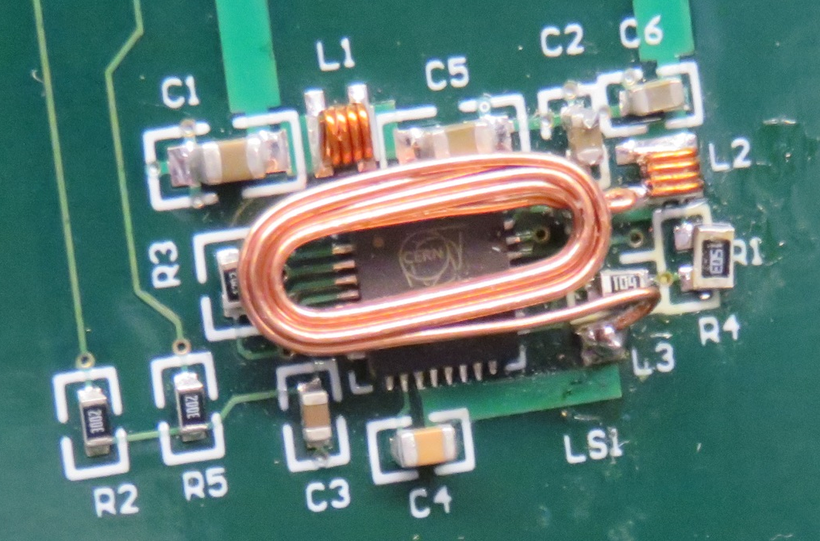
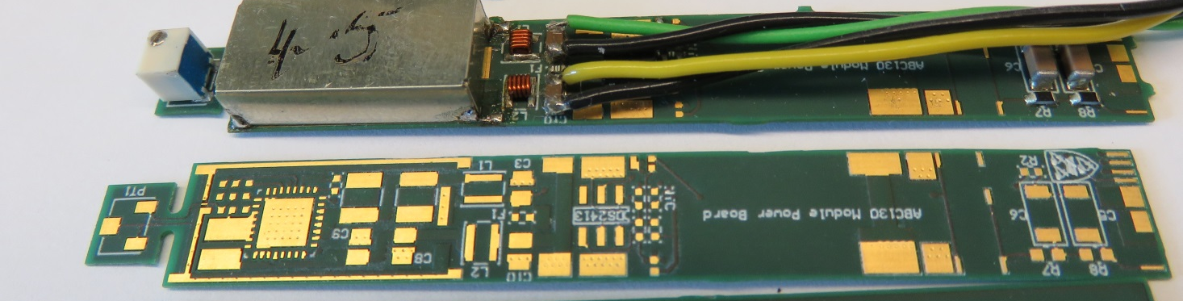
Yale RLS 1
Using Bigger components for hand soldering
Wurth Elektronik
Custom Wound
3 turns x 3 layers = 9 turns
Produced > 100 pieces
Inductor / coil
740 nH / 38.5 mΩ
Ver 3 Squeezed Oval shape for 130 nm Stave design
ABC130 Pwr Bd Plus MUX Liverpool
Using smallest components

Slide 11
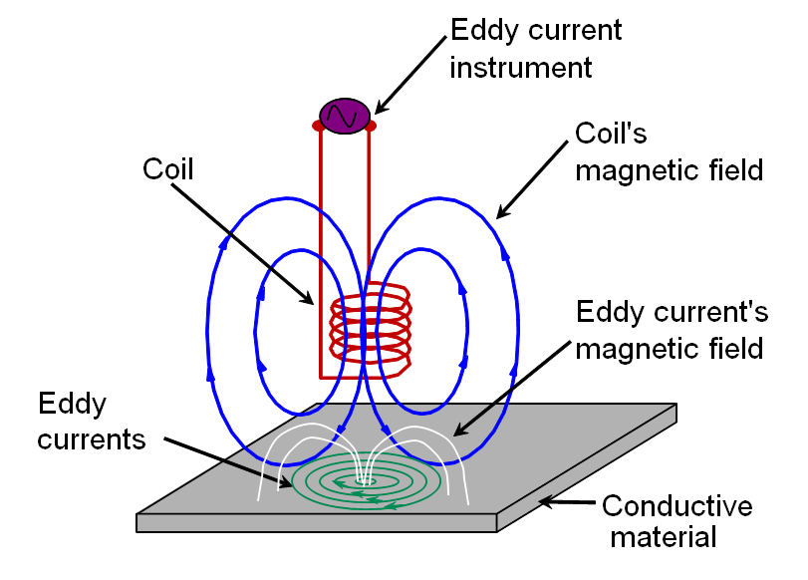
Eddy Current Shield
Field Leakage ???
Close to the Cu Surface
Shield Thiness ≈ Conductivity of Shield
Power Loss ≈ Resistivity of Shield Material
From WWW
Notes:
H: probe mapping close to the shield inhomogeneity

Slide 12
Top view
Fluke Digital Multimeter
10V Power Supply
A
Eddy Current Shield Measurements
Idc Change ≈ Eddy Losses
Driver Panel (encased in an Aluminum box)
Twisted Pair
Translation Stage
Far Side Shield
Near Side Shield
Coil under Test
Side View
Probe2 100A Beehive 0.40 inch loop
Near Side Shield
The Shields
Support
Coil under Test
Far side Shield H3H: Half Oz/ 3 mil thick/ Half Oz
Far Side Shield
4 Types of Near Side Shield
Half Oz/ 3 mil thick/ Half Oz
One Oz/ 3 mil thick/ One Oz
One Oz/ 5 mil Thick/ Zero Oz
One Oz/ 10μm/ One Oz
Center of Coil
Shaft
Translation Stage
1 mm
1.27mm

Slide 13
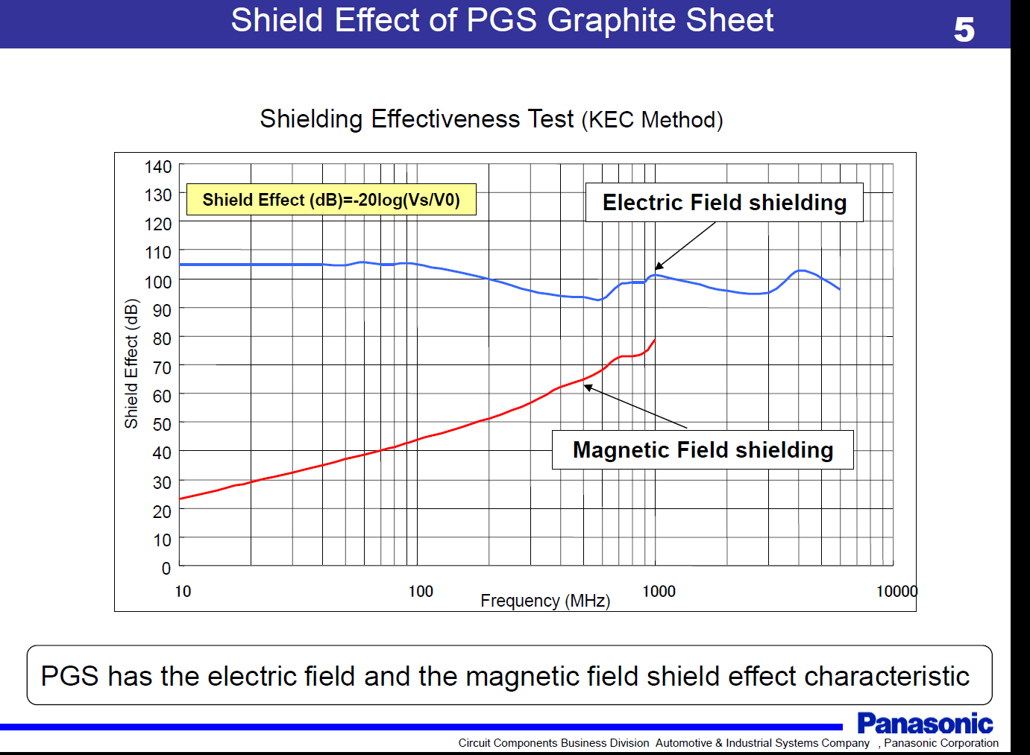
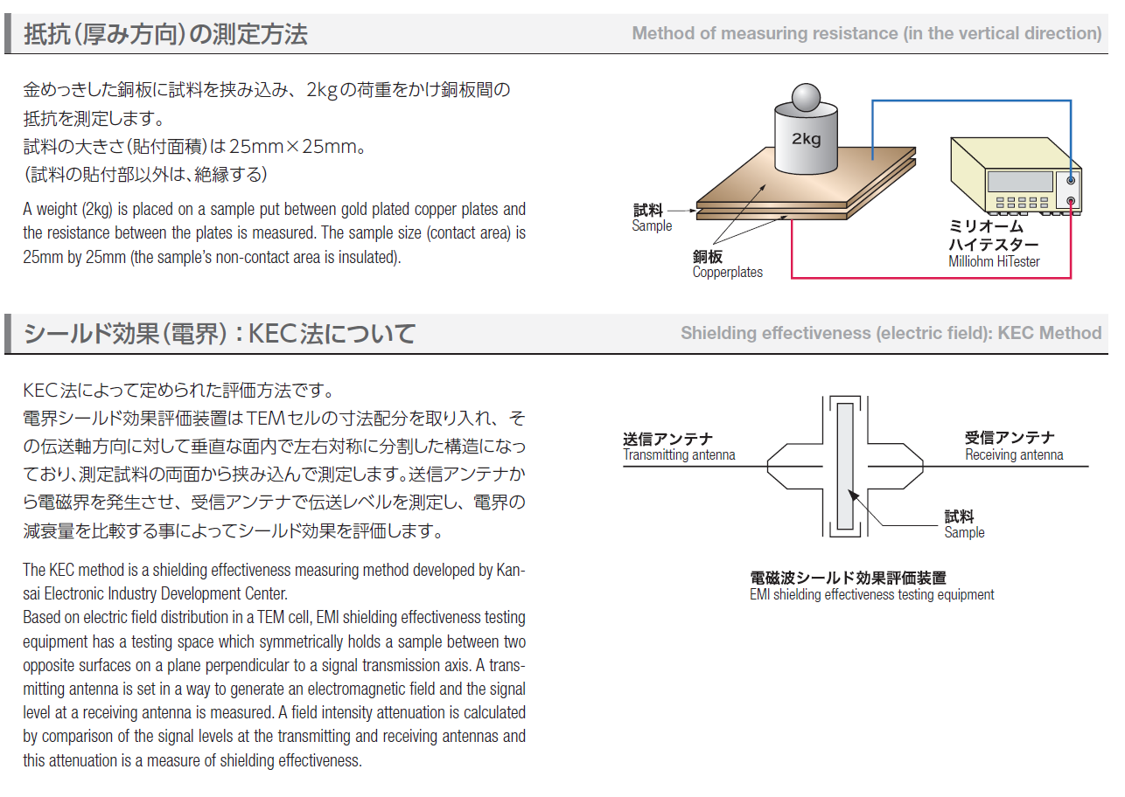
PGS (Pyrolytic Highly Oriented Graphite Sheet) is made of graphite with a structure that is close to a single crystal, which is achieved by the heat decomposition of polymeric film.
PGS is a competitive conductive sheet with high thermal conductivity.
Intrigued by this Chart
Attenuates High Frequencies

Slide 14
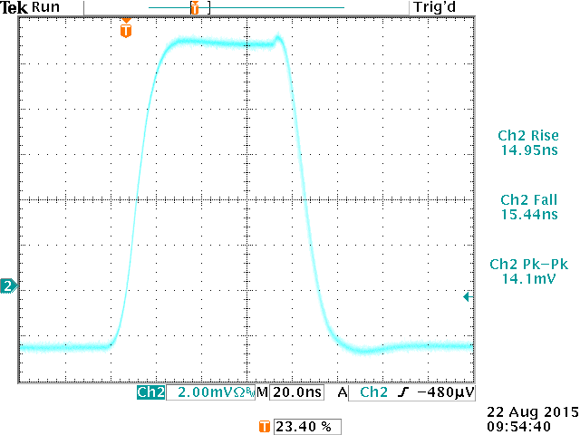
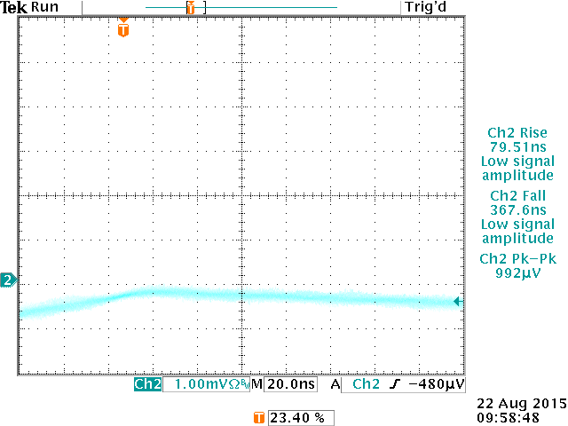
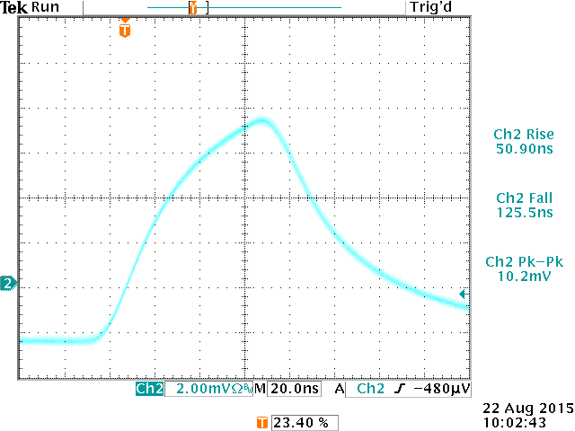
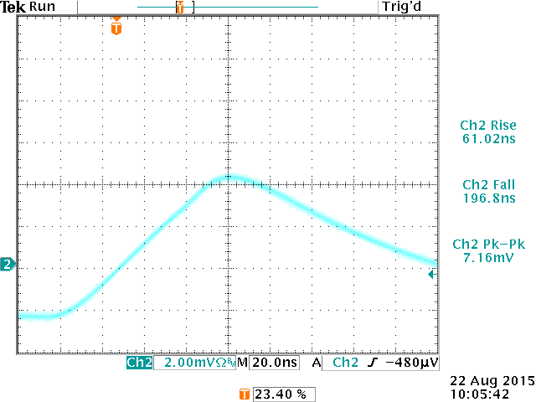
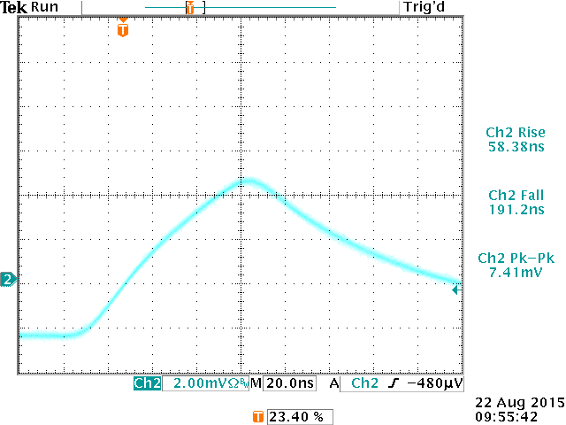
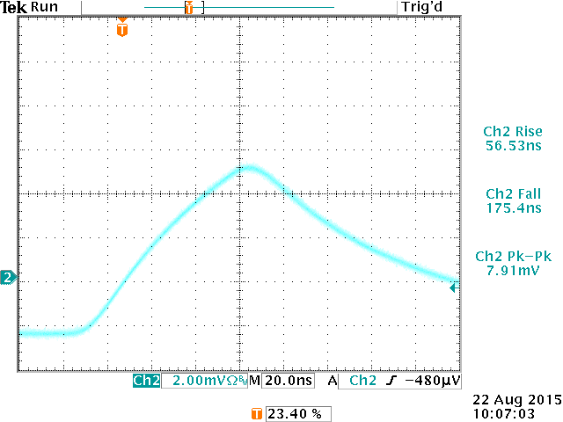
Sample Material/ Attenuator
H Field Attenuation with Gap Material
RLS1 converter
Wurth Coil
Beehive H Field Probe 100A 0.4 inch Dia.
To TDS 3014B Scope
1 cm
Air
9 µm cu
LBL Carbon
Vertical scale is different
Oxford Carbon
P4 Fermilab
P7 PGS
August 22, 2015

Slide 15
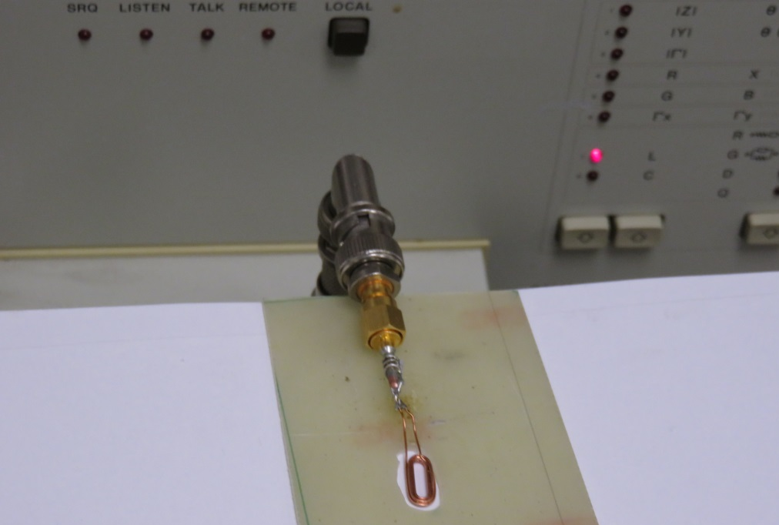
Coil Under Test
With SMA connector

Slide 16
QuadTech LCR 1 MHz
?

Slide 17
QuadTech LCR 1 MHz
Yale Hand Held BK Precision LCR Meter Shows no effect
Maximum Frequency 100 KHz

Slide 18
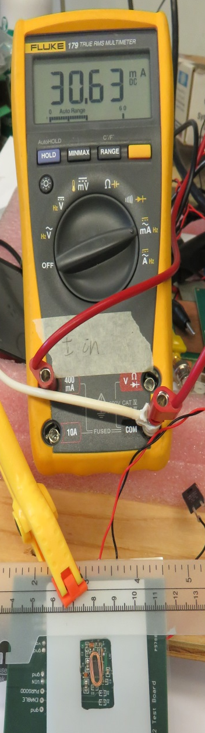
Measure DC Current drawn by Feast2 chip vs
Shield material and distance/gap from top of coil
Wurth Coil | Curremt | Spacers
Shield | mA | Black Mylar = 6 mils each > total = ~30 mils |  |  |  |  |  | FR4 Spacers
 |  | 1 | 2 | 3 | 4 | 5 | 32 mils | 62 mils | 2 x 62 mils
Air | 30.650
Carbon strip | 37.010 | 35.72 | 34.75 | 34.12 | 33.49 | 32.96 | 33.53 | 32.29 | 31.04
P4: Fermilab | 37.160 | 36.08 | 35.11 | 34.16 | 33.55 | 32.51 | 33.74 | 32.32 | 31.26
P7: Pyrolytic | 37.810 | 36.25 | 34.46 | 33.7 | 33.58 | 32.93 | 33.37 | 31.7 | 31.02
P14: 9 µm Cu | 37.860 | 34.12 | 33 | 32.41 | 32 | 31.72 | 31.93 | 31.04 | 30.78
H/5/H | 33.440 | 32.62 | 32.26 | 31.78 | 31.58 | 31.32 | 31.54 | 30.9 | 30.72
Shield Samples
Insulator 6 mils
Wurth Coil
Converter RLS1 With Feast2 Chip

Slide 19
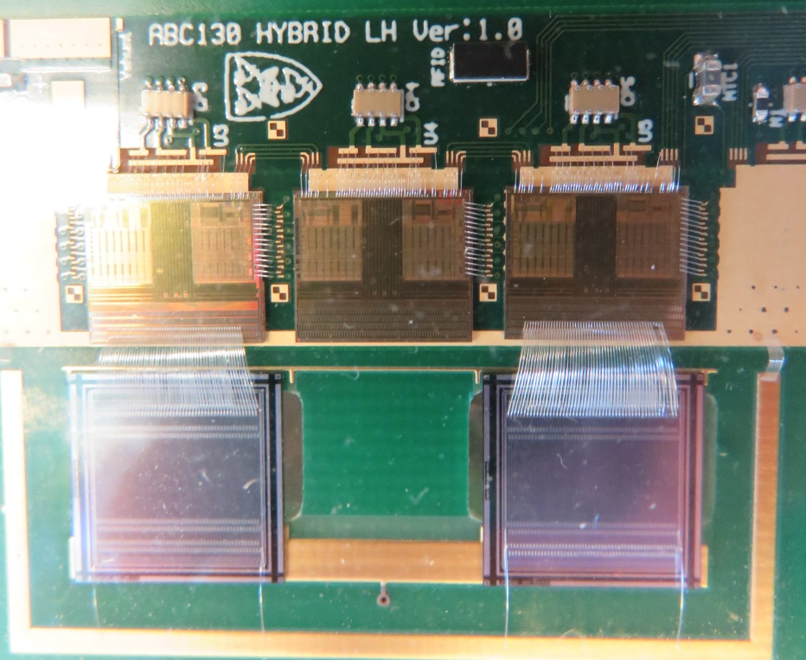
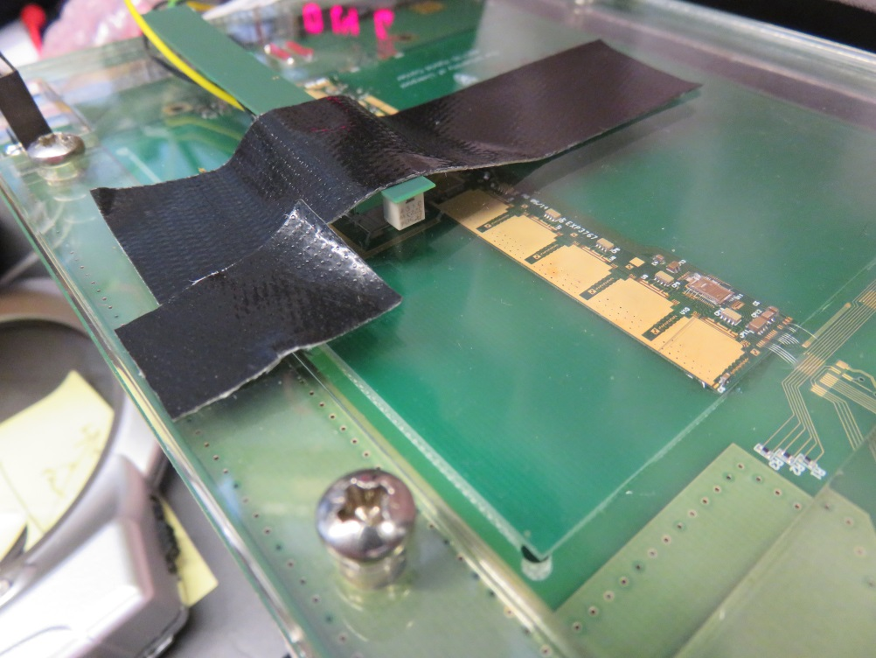
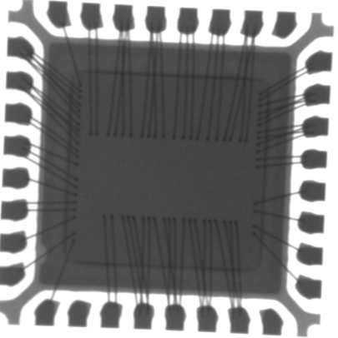
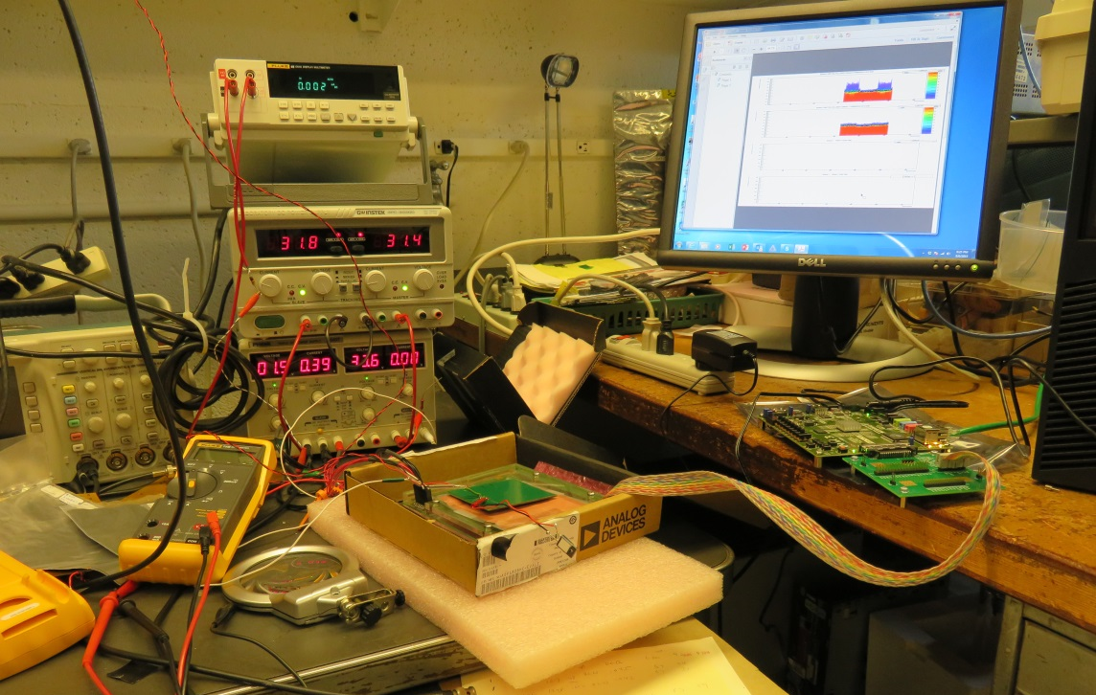
130nm Mini Module
Wire bonds: secondary of transformer for H field
Liverpool Power Board with Shield down
x-ray of Feast2 Chip
Coil on Top may induce noise into FEAST Chip via the wire bonds & PCB Traces
Yale RLS1 Power Bd. with Shield down
Atlys Board + Interface

Slide 20
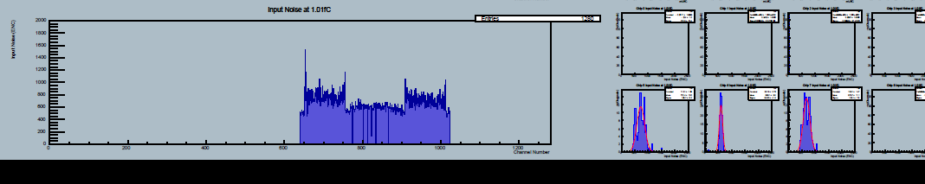
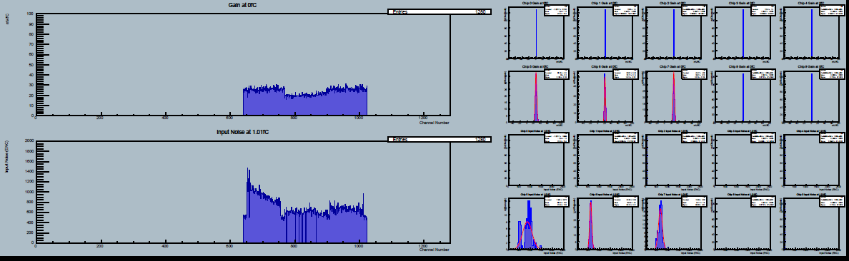
Seek Ashley & Peter’s Help
Yale Run 62 Test Results – August 07, 2015
RLS1 with P4(grounded) with 9 µm Cu Foil added & grounded
RLS1 with P4 (grounded)
Yale Run 61 Test Results – August 07, 2015

Slide 21
Further Work
Investigate / Goals
Shield with Carbon+Copper
(Carbon closer to Inductor)
With shielding we replicate noise numbers as quoted by Ashley
Slope should be the other way around
Understand pickup sensitivity of the sensors

Slide 22
Acknowledgements
Adrian Au
Savannah Thais
DR. Eric Paulson
Prof. Keith Baker
Prof. Steven Lamoreaux

Slide 23
THE END
Questions Please?
Back up Slides

Slide 24
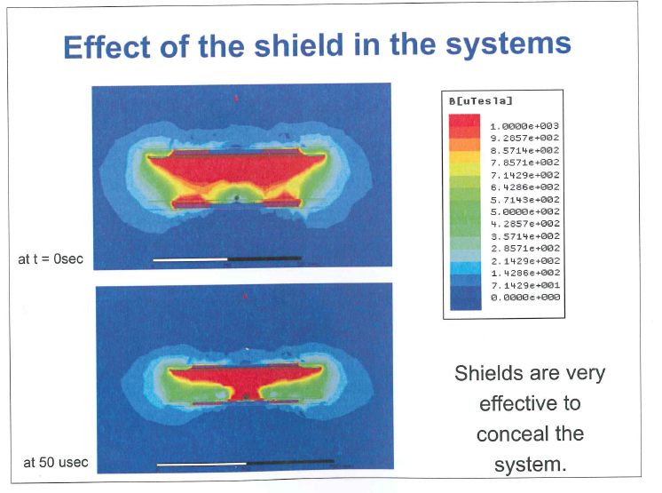
Seminar 9: Wireless charging of EV
Chris Mi . U of Michigan
http://www-personal.engin.umd.umich.edu/~chrismi/
Car Metal
Al Plate 600 mm x 800mm 1 mm thick for mechanical strength
Coil - Top
Coil - Bottom
Frequency = 85 KHz
Power transmitted = 10KW
Inefficiency without Al shield = 20 %
Inefficiency with Al shield = 1 %
Power loss in Car metal without Al shield = 2 KW > 15C rise in temperature
Power loss in Al shield = 0.1 KW
Yale University
March 21, 2014

